Slide 1
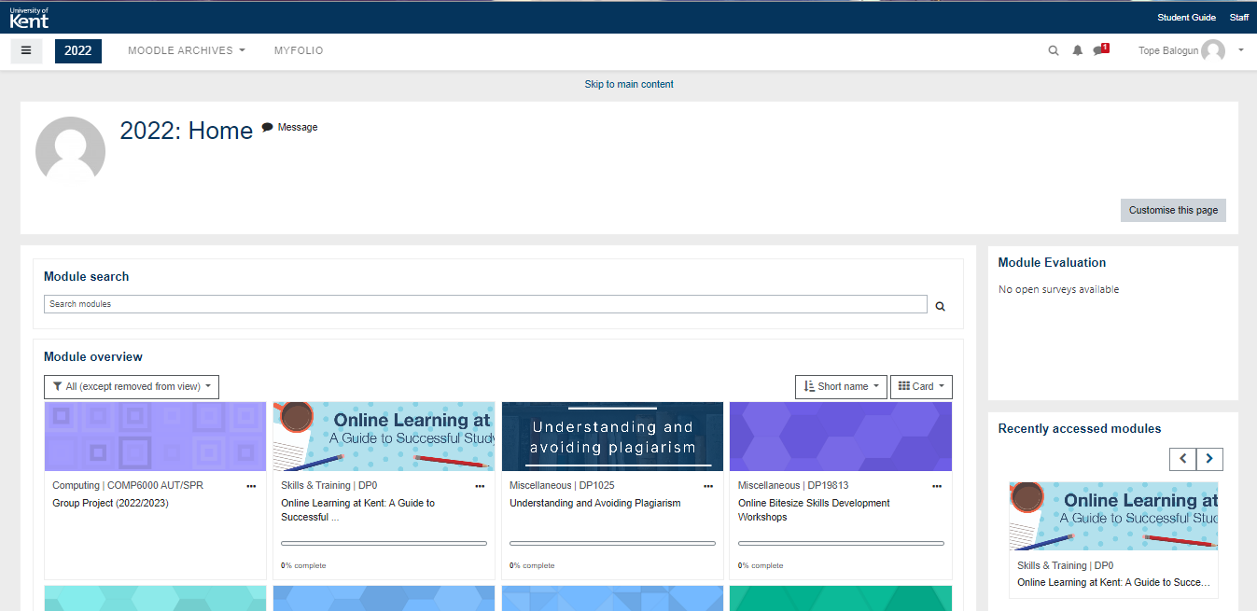
Moodle ++

Slide 2


Moodle++
Be great via Implicit learning
To make old traditional way of learning easier to absorb and interactive !
Lets get Started

Slide 3


Moodle++
Teachers Login
Student Login

Slide 4
Moodle++
Log in
Email
Password
Log in

Slide 5


Moodle++
Create Quiz
View Quiz

Slide 6
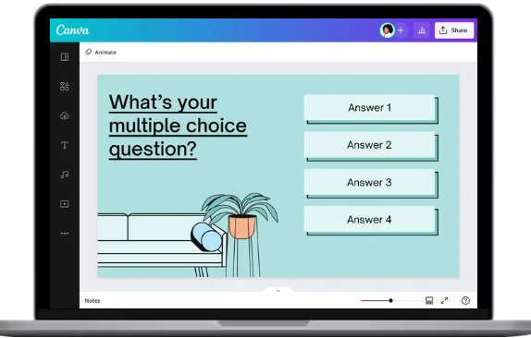
Moodle++
Create !

Slide 7
Moodle++
Teachers Login
Student Login

Slide 8
Moodle++
Log in
Email
Password
Log in

Slide 9
Moodle++
Create Quiz
View Quiz

Slide 10
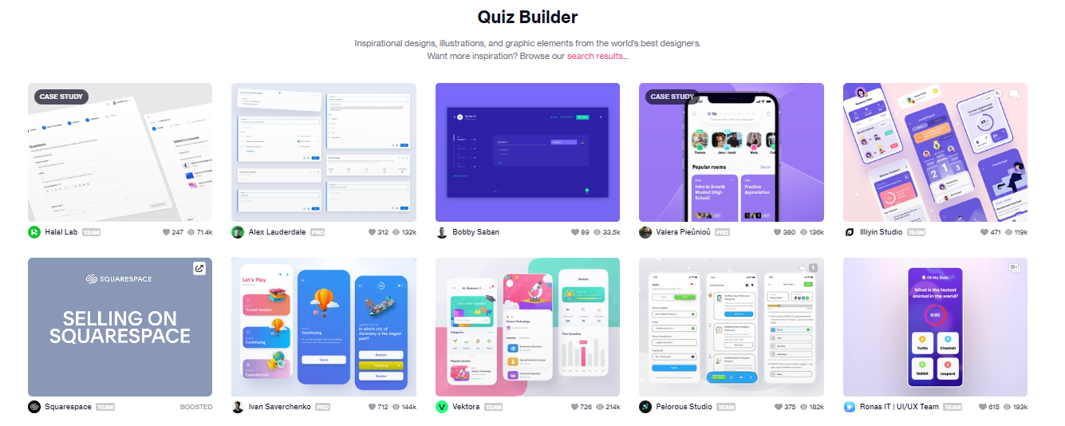
Moodle++

Slide 11





Moodle++
Insert Players
Add
Start!

Slide 12
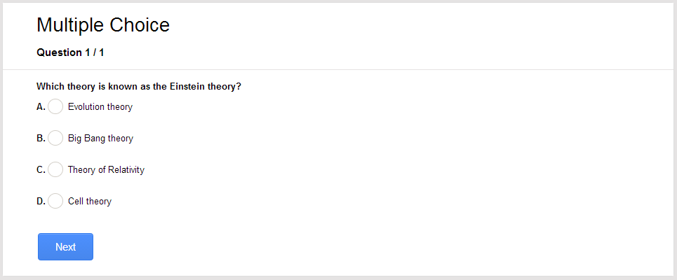
Moodle++
Question 1/5

Slide 13
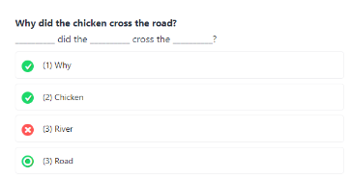
Moodle++
Question 2/5

Slide 14
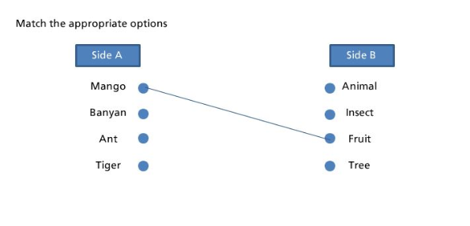
Moodle++
Question 3/5

Slide 15
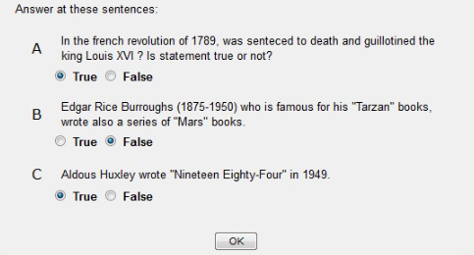
Moodle++
Question 4/5

Slide 16
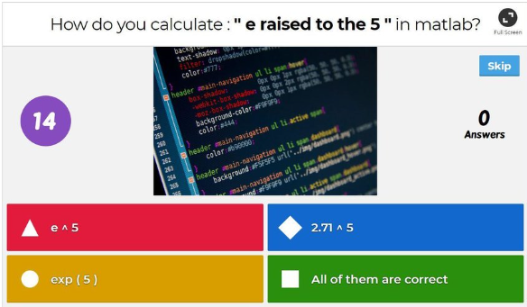
Moodle++
Question 5/5

